Slide 1
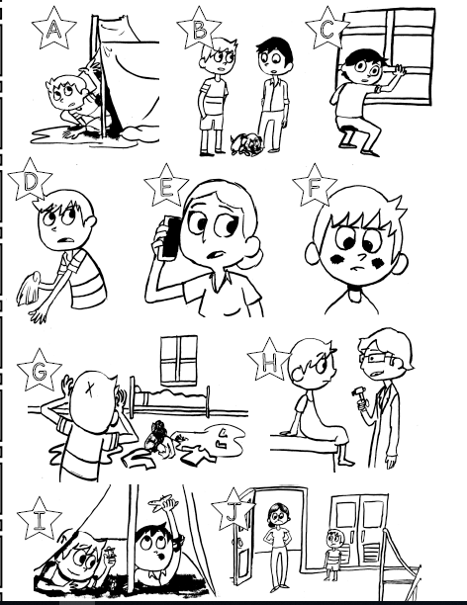
Read chapter 8 and do all the practice activities before completing this.
On a piece of scrap paper, number from 1-10. Write down the letter that corresponds with the recorded phrases.
Submit answers on the chapter 8 listening sheet in TEAMS.

